Slide 1




Hackathon 26
Problem Statement ID – PS-02
Problem Statement Title - Generative AI for Supply Chain Management
PS Category - Software/Hardware
Team Name – CortexChain
Team Leader Name – Abhang Vyawhare (8767449530)

Slide 2


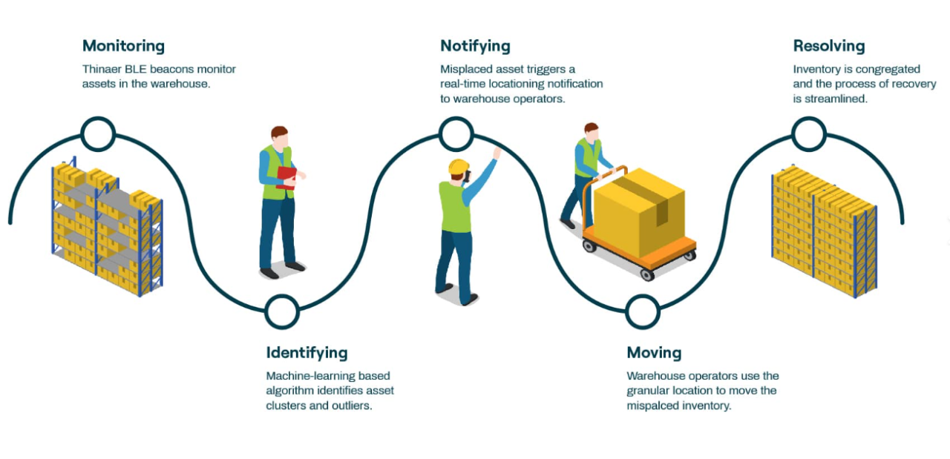
IDEA TITLE
Proposed Solution:
GenAI-powered early warning and decision support system
Predicts supply chain failures before they occur
Simulates future risk scenarios (stockouts, delays, overstock)
How It Addresses the Problem:
Identifies risks days or weeks in advance
Explains cause–effect of failures in natural language
Suggests preventive actions instead of reactive fixes
Innovation & Uniqueness:
Failure simulation instead of only forecasting
Human-readable AI explanations
Proactive, prevention-first approach
PRPCEM HACKATHON' 26

Slide 3





TECHNICAL APPROACH
Technologies Used:
Python for data processing & modeling
ML models for demand & lead-time prediction
Large Language Models (LLMs) for explanations
SQL / Cloud Database for storage
Web dashboard (Streamlit)
Methodology:
Data ingestion from sales, inventory, suppliers, logistics
Risk prediction using ML models
GenAI layer generates explanations & mitigation steps
Conversational interface for managers
PRPCEM HACKATHON' 26

Slide 4

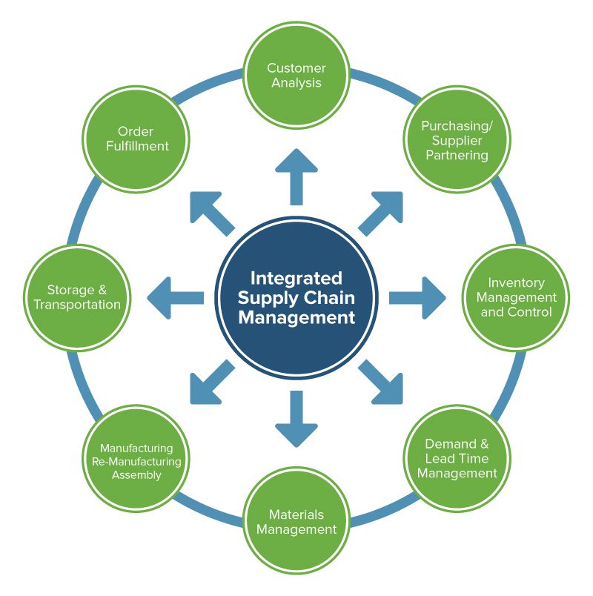
FEASIBILITY AND VIABILITY
Feasibility Analysis:
Uses existing enterprise supply chain data
Can integrate with ERP, WMS, TMS systems
Cloud-based and scalable
Challenges & Risks:
Data quality issues
Trust in AI recommendations
Mitigation Strategies:
Explainable GenAI outputs
Human-in-the-loop decision making
Gradual deployment
PRPCEM HACKATHON' 26

Slide 5


IMPACT AND BENEFITS
Target Audience:
Retailers, FMCG, logistics companies, manufacturers
Impact:
Early detection of supply chain risks
Reduced stockouts and delivery failures
Improved planning and coordination
Benefits:
Economic: cost savings, reduced losses
Operational: proactive decision-making
Business: higher reliability and trust
PRPCEM HACKATHON' 26

Slide 6

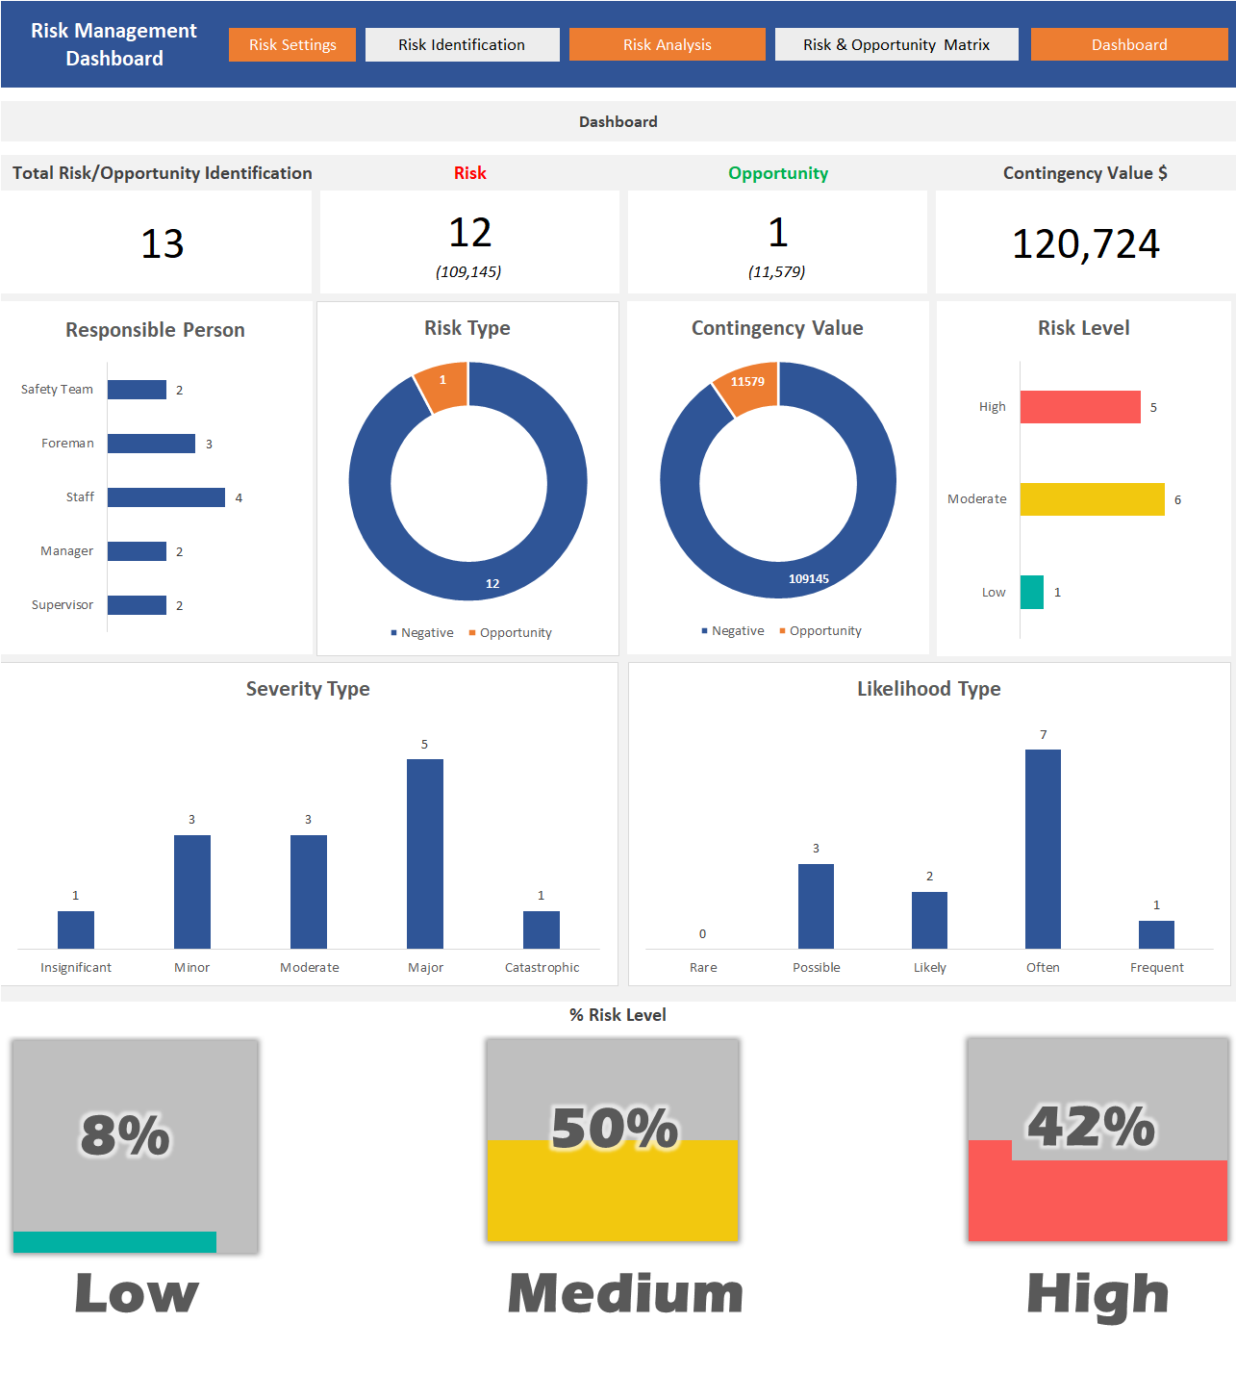
WHAT'S NEXT
Timeline & Implementation Plan:
Phase 1 (Now – 10 Jan 2026)
Finalize data schema (sales, inventory, suppliers, logistics)
Build baseline demand & delay prediction models\
Phase 2 (11 Jan – 15 Jan 2026)
Integrate GenAI for risk explanation and scenario simulation
Develop preventive action recommendation logic
Phase 3 (16 Jan – 18 Jan 2026)
Build interactive dashboard and alert system
Perform testing and refine explanations
Hackathon Day (19 Jan 2026)
Live demo of future failure prediction
Risk explanation and “what-if” scenario walkthrough.
PRPCEM HACKATHON' 25

Slide 7

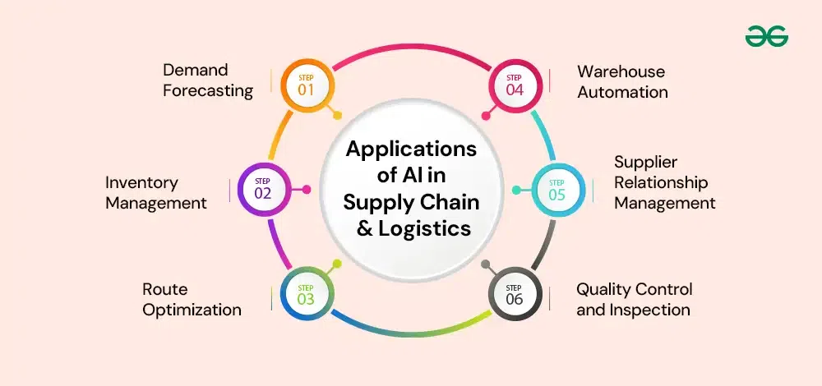
RESEARCH AND REFERENCES
Supply Chain Risk Management studies
Demand Forecasting using Time-Series Models
Explainable AI (XAI) research
Industry reports: McKinsey, Gartner, IBM
GenAI applications in decision support systems
PRPCEM HACKATHON' 26

